Slide 1
SQL Server Query Execution and Plans
Module 7

Slide 3
SQL Server 2019 Workshop Agenda
10:00-12:00 - Morning Session
12:00-13:00 - Lunch Break
13:00-15:00 - Afternoon Session
15:00-15:15 - Break
15:15-16:15 - Afternoon Session - Continue
16:15-16:30 - Wrap-up

Slide 4
Learning Units covered in this Module
Lesson 1: SQL Server Query Execution
Lesson 2: SQL Server Query Optimization
Lesson 3: SQL Server Query Plan Analysis

Slide 5
Lesson 1: SQL Server Query Execution

Slide 6
SQL Server Execution Plan
Execution modes
Row mode execution
Batch mode execution
Efficient for Data Warehousing scenarios
Efficient for OLTP scenarios
Operators read all columns from qualifying rows based on predicate, and for each row it retrieves columns needed for the result set
Used to process multiple rows together
Closely integrated with, and optimized around the ColumnStore storage format
Operators read only the columns required for the result, from group of rows together.
Used with traditional tables, where data is stored in row-wise format.
Starting SQL Server 2019, Batch mode does not require a ColumnStore index as in the previous versions.
Notes:
Execution modes
The SQL Server Database Engine can process Transact-SQL statements using two distinct processing modes:
Row mode execution
Batch mode execution
Row mode execution
Row mode execution is a query processing method used with traditional RDMBS tables, where data is stored in row format. When a query is executed and accesses data in row store tables, the execution tree operators and child operators read each required row, across all the columns specified in the table schema. From each row that is read, SQL Server then retrieves the columns that are required for the result set, as referenced by a SELECT statement, JOIN predicate, or filter predicate.
Row mode execution is very efficient for OLTP scenarios, but can be less efficient when scanning large amounts of data, for example in Data Warehousing scenarios.
Batch mode execution
Batch mode execution is a query processing method used to process multiple rows together (hence the term batch). Each column within a batch is stored as a vector in a separate area of memory, so batch mode processing is vector-based. Batch mode processing also uses algorithms that are optimized for the multi-core CPUs and increased memory throughput that are found on modern hardware.
Batch mode execution is closely integrated with, and optimized around, the ColumnStore storage format. Batch mode processing operates on compressed data when possible and eliminates the exchange operator used by row mode execution. The result is better parallelism and faster performance.
When a query is executed in batch mode, and accesses data in ColumnStore indexes, the execution tree operators and child operators read multiple rows together in column segments. SQL Server reads only the columns required for the result, as referenced by a SELECT statement, JOIN predicate, or filter predicate. Batch mode execution is very efficient in Data Warehousing scenarios, where large amounts of data are read and aggregated.
For further information refer to:
https://docs.microsoft.com/en-us/sql/relational-databases/query-processing-architecture-guide

Slide 7
SQL Server Execution Plan
Main components
Compiled Plan (or Query Plan)
Compilation produces a query plan, which is a read-only data structure used by any number of users.
Execution Context
A data structure used to hold information specific to a query execution, such as parameter values.
Parameter A = ? Parameter B = ? User = ?
Parameter A = 12 Parameter B = ‘xy’ User = Jorge
Parameter A = 100 Parameter B = ‘ftr’ User = Nabil
Parameter A = 11 Parameter B = ‘sd’ User = Walter
Query Plan
Execution Context 1
Execution Context 2
Execution Context 3
Notes:
A query plan is the actual method that SQL Server uses to access data. While a Transact-SQL (T-SQL) statement indicates what the request is, the query plan indicates how to run the request.
Logical operators describe the relational algebraic operation used to process a statement. In other words, logical operators describe conceptually what operation needs to be performed.
Physical operators actually implement the operation defined by a logical operator using a concrete method or algorithm. For example, join is a logical operation, whereas nested loops join is a physical operator.
A Query Plan:
Is also known as an Execution Plan.
Is a re-entrant, read-only data structure used by any number of users.
Contains the data access strategy for the query.
Does not store any user context.
Is never stored more than twice in memory. There is one copy for all serial executions and possibly one copy for all parallel executions. The parallel copy covers all parallel executions, regardless of their degree of parallelism.
An Execution Context is derived from a query plan. Execution contexts:
Hold the values needed for a specific execution of a query plan.
Are cached and reused.
Are created for each user concurrently executing a batch and will hold data (such as parameter values) specific to their execution.
Are not re-entrant. At any point of time, an execution context can be executing only one batch submitted by a session, and while the execution is happening, the context is not given to any other session or user.

Slide 8
SQL Server Execution Plan Caching
Overview
Part of the memory pool used to store execution plans – also known as plan cache.
The plan cache has two stores for all compiled plans:
The Object Plans cache store (OBJCP)
used for plans related to persisted objects (stored procedures, functions, and triggers).
The SQL Plans cache store (SQLCP)
used for plans related to autoparameterized, dynamic, or prepared queries.
Notes:
For further information refer to:
https://docs.microsoft.com/en-us/sql/relational-databases/query-processing-architecture-guide

Slide 9
SQL Server compilation and execution
Concepts
Compilation
Process of creating a good enough query execution plan, as quickly as possible for a query batch.
Refer to both the compilation of non-DML constructs in SQL statements (control flow, DDL, etc.) and the process of Query Optimization.
Query Execution
Process of executing the plan that is created during query compilation and optimization.
Notes:
For further information refer to:
https://docs.microsoft.com/en-us/sql/relational-databases/query-processing-architecture-guide

Slide 10
SQL Server Process Overview
Query Execution
Found
Plan Cache lookup
Not found
Fetch Plan from Cache
Compile and Optimize Query
Need to Recompile?
Y
N
Execute Query
Finish Execution
Notes:
The Query Processor runs in three stages: Parsing, Optimization, and Execution.
When a query is ready to be processed by SQL Server, a query plan is looked up in cache. If it is not there, then a plan has to be created.
The compilation process encompasses a few different steps:
First, there is parsing and normalization. This is done for the batch, which potentially breaks down a single query into multiple, fine-grained queries.
Second, the query is compiled. We will see how that is done in the next slides.
Third, in the optimization stage, The Query Processor does what is also known as cost-based optimization, where resource usage drives the optimizer choices. The optimizer will try to minimize I/O, memory consumption, CPU, and the time it takes to run a query, evaluating almost 400 rules in the process. We will discuss some of these rules later.
It is also important to refer that query optimization stops after finding a good enough query plan, not the best one, because iterating through hundreds to thousands of possible plans in a small amount of time would be too expensive.
Fourth and last, the new query plan is placed in the plan cache.
After the plan has been put in the cache, the SQL Server Manager retrieves it, goes back through the logic in terms of execution, and checks to see if anything has changed, and whether the plan needs to be recompiled again due to correctness issues. Even though there are only microseconds separating compilation from execution, somebody might have executed a Data Definition Language (DDL) statement that added an index to a table that will be used, or new statistics are available that require reevaluation in terms of the physical operators to use, or it may find stalled statistics that need to be updated, or even some hint exists that forces recompilation.
If the plan that is found in THE cache does not need to be recompiled, a memory grant is requested, the size of which is based on the cardinality estimations and the chosen operators for the plan.
Memory grant process The server calculates how much memory to grant for a given query, and then uses the internal facility called Resource Semaphore to reserve actual memory, or throttle it if too many queries request for memory. Resource Semaphore is responsible for satisfying memory grant requests while keeping overall memory grant usages within the server limit.
Before a query is run, the server checks whether a memory grant is needed or not. If not needed, the server can start the query immediately. For example, a simple serial query without ORDER BY or GROUP BY may not need a memory grant. The server calculates the memory limit for one query. By default, this is 25% of total query workspace memory. The server calculates the ideal memory for the query and checks if the ideal memory exceeds the per-query limit. If it does, then the server reduces the additional memory until the total fits within the limit. This revised size is called requested memory. The server asks Resource Semaphore to grant the requested memory.
After that, the plan is sent to the query executor as we have seen earlier, and it will run to completion.
Running the plan
SQL Server performs a step called opening the plan, which starts the actual execution and then the plan runs to completion. If your query is using the default result set model, the plan will actually just run until it has produced all of its rows and these have all been sent back to the client.
However, if you are using the cursor model, the processing is a bit different. Each client requests only one block of rows, not all of them. After each block is sent back to the client, SQL Server must wait for the client to request the next block. While it is waiting, the entire plan is quiesced, which means that some of the locks are released, some resources are given up, and some positioning information is cached. When the next block of rows is requested, this cached information enables SQL Server to resume where it left off.
For further information refer to
https://docs.microsoft.com/en-us/sql/relational-databases/query-processing-architecture-guide
Plan Caching and Recompilation in SQL Server 2012 - https://docs.microsoft.com/en-us/previous-versions/sql/sql-server-2012/dn148262(v=msdn.10)
Understanding SQL server memory grant - http://blogs.msdn.com/b/sqlqueryprocessing/archive/2010/02/16/

Slide 11
SQL Server compilation
Dissecting and transforming SQL statements into compiler-ready data structures
Syntax validation to ensure it is legal
Process overview
Object binding:
verifying that the tables and columns exist
Expanding view definition
Loading metadata information
Syntax-based optimizations
Notes:
The compilation stage in more detail
During the compilation process, SQL Server parses each statement, dissecting and transforming SQL statements into compiler-ready data structures, including syntax validations to help ensure that it is legal.
Then, it creates something called a sequence tree or algebrized tree that is the internal representation of the statement.
The sequence tree is then normalized. The main function of the normalizer is to perform binding, which includes verifying that the tables and columns exist and loading the metadata for the tables and columns. Information about implicit conversions is also added to the sequence tree. For example, if the query is trying to add 10.0 to an integer value, SQL Server will insert an implicit convert into the tree.
Normalization also replaces references to a view with the definition of that view (called expanding the view). Finally, normalization includes a few syntax-based optimizations.
If the statement is a DML statement, SQL Server extracts information from the sequence tree about that query and creates a special structure called a query graph, which is set up to let the optimizer work on it effectively.
The query graph is then optimized, and a plan is produced and put in the plan cache.
If the statement is DDL, then produce a trivial plan, a 0 cost plan.

Slide 12
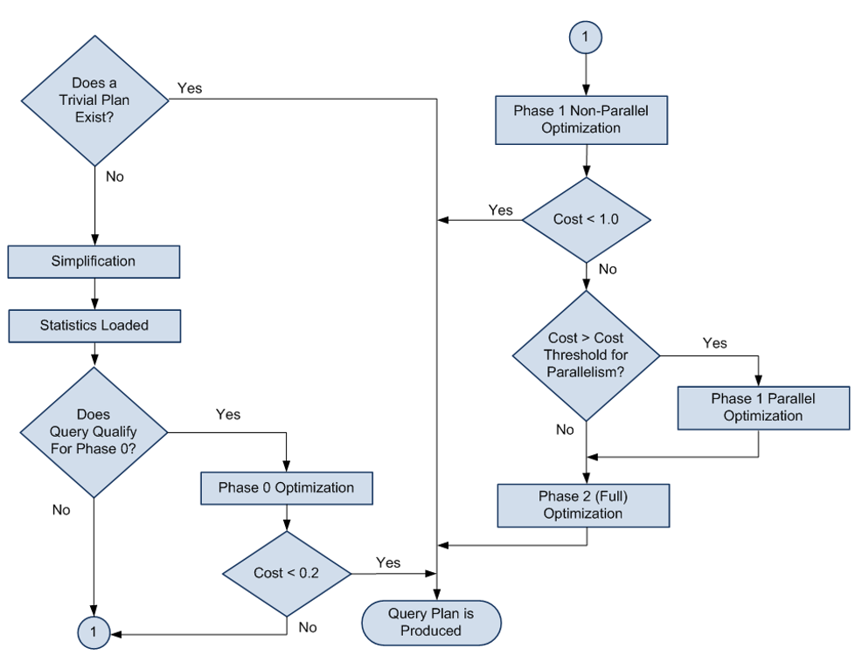
SQL Server optimization
Process overview
The Query Optimizer:
Uses a logic based on cost estimation.
Does not analyze ALL possible plans.
Uses a phased approach where, on each phase, it add more for cost analysis.
On each phase it uses phase cost threshold to find a plan with lower cost than the threshold.
Plan cost is a calculation of estimated computing resources needed.
simple queries with three or fewer tables
Notes:
The SQL Server Query Optimizer is a cost-based optimizer. Each possible execution plan has an associated cost in terms of the amount of computing resources used. The Query Optimizer must analyze the possible plans and choose the one with the lowest estimated cost. Some complex SELECT statements have thousands of possible execution plans. In these cases, the Query Optimizer does not analyze all possible combinations. Instead, it uses complex algorithms to find an execution plan that has a cost reasonably close to the minimum possible cost.
The SQL Server Query Optimizer does not choose only the execution plan with the lowest resource cost; it chooses the plan that returns results to the user with a reasonable cost in resources and that returns the results the fastest. For example, processing a query in parallel typically uses more resources than processing it serially, but completes the query faster. The SQL Server Query Optimizer will use a parallel execution plan to return results if the load on the server will not be adversely affected.
The SQL Server Query Optimizer relies on distribution statistics when it estimates the resource costs of different methods for extracting information from a table or index.
The SQL Server Query Optimizer is important because it enables the database server to adjust dynamically to changing conditions in the database without requiring input from a programmer or database administrator. This enables programmers to focus on describing the final result of the query. They can trust that the SQL Server Query Optimizer will build an efficient execution plan for the state of the database every time the statement is run.
Trivial plan optimization
If SQL Server knows that there is only one viable plan for a query, a lot of work can be avoided. For example, where there is only one possible plan:
A query that consists of an INSERT with a VALUES clause.
A SELECT statement for which all the columns are among the keys of a unique composite index, and that index is the only one that is relevant. No other index has that set of columns in it.
The trivial plan query optimizer finds the really obvious plans that are typically very inexpensive. This saves the query optimizer from having to consider every possible plan, which can be costly and can outweigh any benefit provided by well-optimized queries.
Simplification
If there is no trivial plan, SQL Server will perform a simplification. These are usually syntactic transformations of the query itself, to look for commutative properties and operations that can be rearranged. There is no cost or available index analysis. SQL Server then loads up the metadata, including the statistical information on the indexes.
Cost-based optimization
A set of transformation rules is followed that apply various permutations of data access strategies, join orders, aggregation placement, subquery transformations, and other rules that guarantee that a correct result is returned.
Optimization is broken up into three search phases to prevent the process from taking much longer than the execution of the query.
SQL Server evaluates the cost of the cheapest plan after each phase and executes that plan, if the plan is cheap enough. Otherwise, the query optimizer runs the next phase, which involves another set of usually more complex rules.
Phase 0 – Transactional Processing Phase: Contains a very limited set of rules and is applied only to simple queries with three or fewer tables. A limited number of join orders are evaluated, which may generate many potential plan candidates. Hash and nested loop join strategies are considered. If a plan with an estimated cost below 0.2 is found, the optimization ends and the query is executed. This phase is also known as the Transaction Processing phase, because query plans produced by this phase are typically found for queries in online transaction processing (OLTP) applications.
Phase 1 – Quick Plan Optimization Phase: More transformation rules and different join orders are evaluated. If the best plan costs less than 1.0, the optimization ends.
The query optimizer has considered only non-parallel execution plans so far. Phase 1 is repeated with the goal of finding the best parallel plan if:
More than one logical CPU is available to SQL Server.
The least expensive plan produced by Phase 1 costs more than the Cost Threshold for Parallelism.
The cost is >= 1.
Phase 2 – Full Optimization Phase: The cost of the serial and parallel plans are compared and Phase 2 is executed for the cheaper plan. Outer join reordering and automatic indexed view substitution for multi-table views are also considered.
An internal timeout can occur and the Query Optimizer stops the optimization process and returns the least expensive plan it has found so far. This timeout event is also shown on the properties of a graphical plan as Reason For Early Termination of Statement Optimization or on an XML plan as StatementOptmEarlyAbortReason.
We should be aware that if the full optimization phase produced a parallel plan for this query, it does not necessarily mean that the plan will be executed on multiple processors. If the machine is very busy, and cannot support running a single query on multiple CPUs, the plan will utilize a single processor.

Slide 13
SQL Server Execution Plan Recompilations
Overview
Most recompilations are required either for statement correctness or to obtain potentially faster query execution plan.
The engine detects changes that invalidate execution plan(s) and marks those as not valid. New plan must be recompiled for the next query execution.
Starting with SQL Server 2005, whenever a statement within a batch causes recompilation, only the statement inside the batch that triggers recompilation is recompiled.
Notes:
Further Reading: Query Processing Architecture Guide - SQL Server | Microsoft Learn
Plan Caching and Recompilation in SQL Server 2012 - https://docs.microsoft.com/en-us/previous-versions/sql/sql-server-2012/dn148262(v=msdn.10)

Slide 14
SQL Server Execution Plan Recompilations
Recompilation reasons
Table / Index Changes
Changes made to objects referenced by the query (ALTER TABLE and ALTER VIEW).
Changing or dropping any indexes used by the execution plan.
Stored Procedures
Changes made to a single procedure, which would drop all plans for that procedure from the cache (ALTER PROCEDURE).
Explicit call to sp_recompile.
Executing a stored procedure using the WITH RECOMPILE option.
Data Volume
Updates on statistics used by the execution plan
For tables with triggers, if the number of rows in the inserted or deleted tables grows significantly.
Other
Large numbers of changes to keys (generated by statements from other users that modify a table referenced by the query).
Temporary table changes
Notes:
Further Reading: Query Processing Architecture Guide - SQL Server | Microsoft Learn
Plan Caching and Recompilation in SQL Server 2012 - https://docs.microsoft.com/en-us/previous-versions/sql/sql-server-2012/dn148262(v=msdn.10)

Slide 15
Lesson 2: SQL Server Query Optimization

Slide 16
Optimizations
Join reordering
Goal
Reduce the row-count of each join as early as possible
Join-paths between tables may differ from the actual written Transact-SQL form.
Queries can be represented as trees, in accordance with the Joined tables: Linear trees or Bushy trees.
Uses Indexes and Statistics.
Notes:
As part of the optimization process, the Query Optimizer tries to find the optimal JOIN order by using some experimentation, evaluation, or that narrow the number of JOINs to test.
Then, it also uses statistics and indexing to find what would be a good enough order in which to JOIN tables by using the least resources.
Queries are represented as trees in the query processor and names such as left-deep, right-deep, and bushy trees are commonly used to identify the shapes of the order of joins in these trees. The shape of the tree is directly influenced by the types of JOINs we input in Transact-SQL.

Slide 17
Optimizations
Join reordering example
Left Tree
Bushy Tree
SELECT *
FROM tA
JOIN tB ON tA.c1 = tB.c1
JOIN tC ON tB.c1 = tC.c1
JOIN tD ON tC.c1 = tD.c1
SELECT *
FROM (tA JOIN tB ON tA.c1 = tB.c1)
JOIN (tC JOIN tD ON tC.c1 = tD.c1)
ON tB.c1 = tC.c1
Notes:
The left image is an example of a JOIN that will derive in a LEFT tree.
The right image is an example of a JOIN that will derive in a Bushy tree, meaning that we have both LEFT and RIGHT linear trees.
Remember that the optimizer does not aim to do the absolutely best job, but a job that is good enough to process our queries as efficiently as possible.

Slide 18
Optimizations
Query parallelism
Queries are parallelized by horizontally partitioning data and assigning a thread to each partition.
Some constructs can inhibit parallelism.
Used by SQL Server to reduce the run-time of a query.
CPU
.085
CPU
Parallel execution
CPU TIME: 0.302
Elapsed Time: 0.335
.057
CPU
.070
CPU
.090
Serial Execution
CPU Time: 0.132
Elapsed Time: 0.580
CPU
.132
Elapsed Time (s)
.335
.580
Notes:
The goal of executing a query on parallel threads is not to reduce resource usage, only the clock-time of the query.
Parallelization of a query is achieved by horizontally partitioning data into sets. Each set has the same operation performed on it at the same time.
DOP is determined at the start of execution, based on:
The number of logical CPUs available to SQL Server.
The Max Degree of Parallelism (MAXDOP) setting.
The Max Worker Threads setting.
The query MAXDOP hint.
Resource Governor Working Group MAXDOP setting.
SQL Server chooses a DOP that maximizes parallelism while ensuring that it does not run out of worker threads. MAXDOP= 1 removes all parallelism iterators and runs the query by using a serial plan on a single thread.
The number of threads used by a parallel query may exceed the DOP. The DOP determines the number of threads per operator; not the total number of threads per query plan. The DOP limits the number of schedulers to the selected DOP. All threads used by the query are assigned to the same set of DOP schedulers and the query uses only DOP CPUs, regardless of the total number of threads.
Constructs that inhibit parallelism include:
Scalar UDFs
Remote Query
Dynamic cursors
Recursive queries
Table Valued Functions (TVFs)
TOP keyword
For further information refer to:
https://docs.microsoft.com/en-us/sql/relational-databases/query-processing-architecture-guide#parallel-query-processing

Slide 19
Optimizations
Constraints
Query Optimizer
Type of Constraints used for optimization
Unique constraints
Check constraints
Foreign keys
Contradiction Detection
Collects information from predicates, join conditions and constraints to reason about how they can be used to optimize the query.
Determine if a query is written in such a way as to never return any rows at all.
When a contradiction is detected:
Query does not run.
Execution plan shows a CONSTANT SCAN.

Slide 20
Hint Types
Query Hints
Applied to the whole query using the OPTION clause
Table Hints
Applied to single tables in the query
Join Hints
Applied to specific joins only
Use Hints
Examples: MAXDOP, RECOMPILE, OPTIMIZE FOR
Examples: FORCESEEK, FORCESCAN, and INDEX
Examples: LOOP, MERGE, and HASH
Provides one or more additional hints to the query processor.
Example: ENABLE_QUERY_OPTIMIZER_HOTFIXES
Notes:
Hints are options or strategies specified for enforcement by the SQL Server query processor on SELECT, INSERT, UPDATE, or DELETE statements. The hints override any execution plan the query optimizer might select for a query.
Caution
Because the SQL Server Query Optimizer typically selects the best execution plan for a query, we recommend only using hints as a last resort for experienced developers and database administrators.
For detailed information of each query hint refer to: Query Hints (Transact-SQL) - SQL Server | Microsoft Learn
Query hints specify that the indicated hints should be used throughout the query. They affect all operators in the statement. If UNION is involved in the main query, only the last query involving a UNION operation can have the OPTION clause. Query hints are specified as part of the OPTION clause. Error 8622 occurs if one or more query hints cause the Query Optimizer not to generate a valid plan.
Applies to:
DELETE, INSERT, SELECT, UPDATE and MERGE
For detailed information of each table hint refer to: Hints (Transact-SQL) - SQL Server | Microsoft Learn
Table hints override the default behavior of the query optimizer for the duration of the data manipulation language (DML) statement by specifying a locking method, one or more indexes, a query-processing operation such as a table scan or index seek, or other options. Table hints are specified in the FROM clause of the DML statement and affect only the table or view referenced in that clause.
Applies to:
DELETE, INSERT, SELECT, UPDATE and MERGE
For detailed information of each named use hint refer to: Join Hints (Transact-SQL) - SQL Server | Microsoft Learn
Applies to:
DELETE, SELECT and UPDATE
For detailed information of each named use hint refer to: Query Hints (Transact-SQL) - SQL Server | Microsoft Learn
There’s also a new DMV sys.dm_exec_valid_use_hints that lists supported name hints. This is not meant a dictionary, but rather as a tool that will allow a developer to determine if a specific hint is available in a given version, where code is intended to execute, before it actually does.
USE HINT ( 'hint_name' )
Applies to: SQL Server (starting with SQL Server 2016 (13.x) SP1) and Azure SQL Database.
Provides one or more additional hints to the query processor. The additional hints are specified by a hint name inside single quotation marks.
Applies to:
DELETE, INSERT, SELECT, UPDATE and MERGE

Slide 21

Demonstration
Optimizations
Parallelism optimization
Join reordering optimization
Notes:
Previous demonstration files are under E:\Archived.
You can open all the demonstrations by using the solutions file :
E:\Demos\SQL_PTO_Workshop_Demos.ssmssln
Individual SQL demo file.
E:\Demos\07_Execution_Plans\Parallelism optimization.sql
E:\Demos\07_Execution_Plans\\Join reordering optimizations.sql

Slide 22

Constraint Optimization
Check constraint optimization
UNIQUE constraint optimization
Join elimination optimization
Notes:
M07L02Lab01

Slide 23
Lesson 3: SQL Server Query Plan Analysis

Slide 24
How to see the query plan
Graphical execution plan
Estimated Execution Plan (Before Execution)
Live Query Statistics (During Execution)
Actual Execution Plan (After Execution)
The compiled plan.
The same as the compiled plan plus its execution context.
The same as the compiled plan plus its execution context.
This includes runtime information available after the execution completes, such as execution warnings, or in newer versions of the Database Engine, the elapsed and CPU time used during execution.
This includes runtime information during execution progress and is updated every second. Runtime information includes for example the actual number of rows flowing through the operators.
Enables rapid identification of potential bottlenecks.

Slide 25
Contents of an Execution Plan
Methods used to extract data from each table.
How data is joined
Use of temporary worktables and sorts
Estimated rowcount, iterations, and costs from each operator
Actual rowcount and iterations
Sequence in which the source tables are accessed.

Slide 26
How to see the query plan
Text and XML
 | Command | Execute query? | Include estimated row counts & stats (Estimated Query Plan) | Include actual row counts & stats (Actual Query Plan)
Text Plan | SET SHOWPLAN_TEXT ON | No | No | No
 | SET SHOWPLAN_ALL ON | No | Yes | No
 | SET STATISTICS PROFILE ON | Yes | Yes | Yes
XML Plan | SET SHOWPLAN_XML ON | No | Yes | No
 | SET STATISTICS PROFILE XML | Yes | Yes | Yes

Slide 27
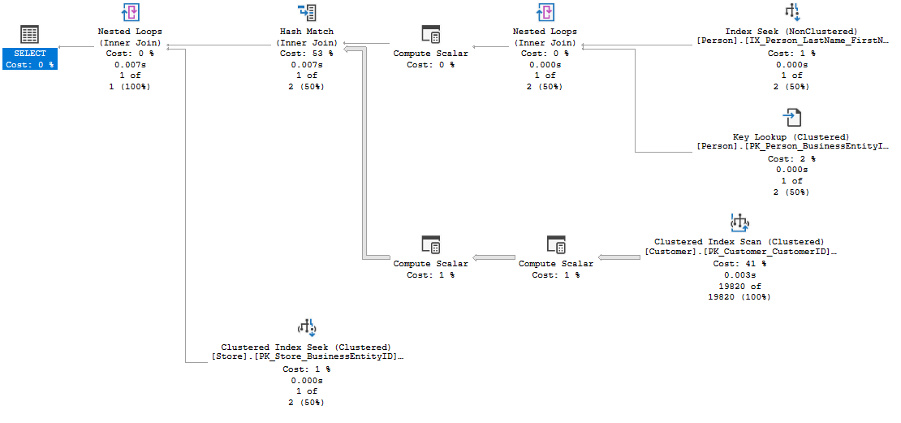

SSMS Graphical Plan
Execution Flow
5
3
1
3
Outer
Table
2
Inner table
The basic guidelines for analyzing a query plan are:
Flow of data is read from right to left.
The width of the arrows gives an indication of the number of rows in each dataset, such as the one coming from the
Customer table CL IX scan. This can often be a clue to high resource usage.
For joins:
The outer table appears on top.
Resultsets are created from each join pair,
which is then passed to the next join.
Two crucial facts affect join performance:
The order in which more than two tables are joined.
The selection of outer/inner table.
Joins producing smaller result sets are performed first.
Local predicates are applied before the join.
Joins that reduce the number of rows are performed first.
Aggregation may be performed before the join.
4
6
SELECT p.Title + ' ' + p.FirstName + ' ' + p.LastName AS FullName, c.AccountNumber, s.Name
FROM Person.Person AS p
INNER JOIN Sales.Customer AS c ON c.PersonID = p.BusinessEntityID
INNER JOIN Sales.Store AS s ON s.BusinessEntityID = c.StoreID
WHERE p.LastName = 'Koski’
Notes:
The basic guidelines for analyzing a query plan are:
Flow of data is read from right to left.
The width of the arrows gives an indication of the number of rows in each dataset, such as the one coming from the Customer table CL IX scan. This can often be a clue to high resource usage.
For joins:
The outer table appears on top.
Resultsets are created from each join pair, which is then passed to the next join.
Two crucial facts affect join performance:
The order in which more than two tables are joined.
The selection of outer/inner table.
Joins producing smaller result sets are performed first.
Local predicates are applied before the join.
Joins that reduce the number of rows are performed first.
Aggregation may be performed before the join.
This is all dependent on the accuracy of the statistics the Microsoft SQL Server Query processor has at compilation time.
Example Query:
SELECT p.Title + ' ' + p.FirstName + ' ' + p.LastName AS FullName, c.AccountNumber, s.Name
FROM Person.Person AS p
INNER JOIN Sales.Customer AS c ON c.PersonID = p.BusinessEntityID
INNER JOIN Sales.Store AS s ON s.BusinessEntityID = c.StoreID
WHERE p.LastName = 'Koski’
Resultset 1 and 2 are joined using a nested loops join, creating resultset 3.
Resultsets 3 and 4 are joined using a hash match join, creating resultset 5.
Resultsets 5 and 6 are joined using a nested loops join, creating a resultset for the Select clause.

Slide 28
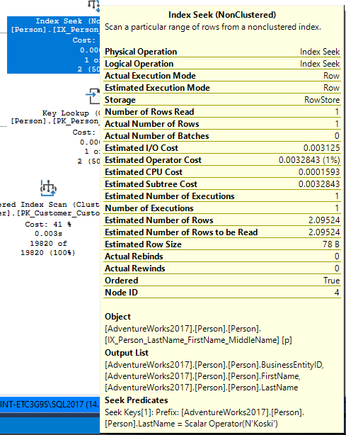
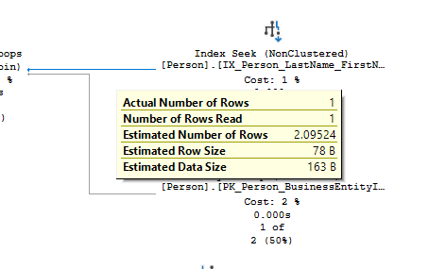
SSMS Graphical Plan
Data flow between the operators and statistical data of each operator
Statistical data for the operator
Data flow statistics
Notes:
Arrows represent the data flow between the iterators.
ToolTips provide detailed help, including a description of statistical data on each iterator; this includes estimates of the number of rows generated by each operator (that is, the cardinality estimates), the average row size, and the cost of the operator.

Slide 29
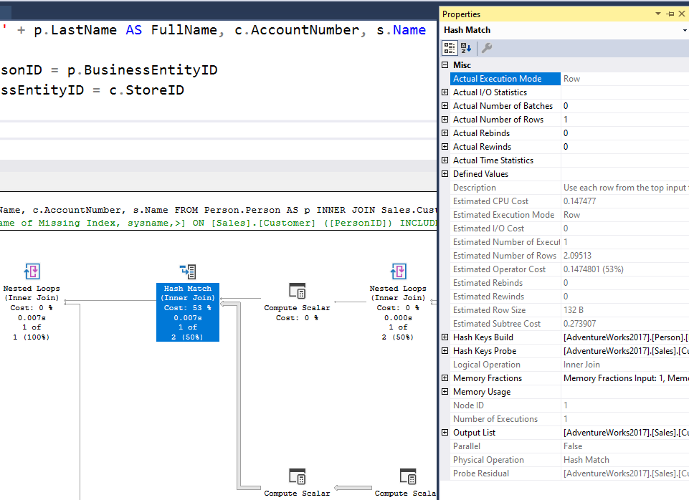
SSMS Graphical Plan
Properties sheet
Management Studio Properties sheet includes even more detailed information about each operator and about the overall query plan.
Use the most recent version of Management Studio as every new version display more detailed information about the Query Plan when examining the plan in graphical mode.
Notes:
The Management Studio Properties sheet includes even more detailed information about each operator and about the overall query plan.

Slide 30
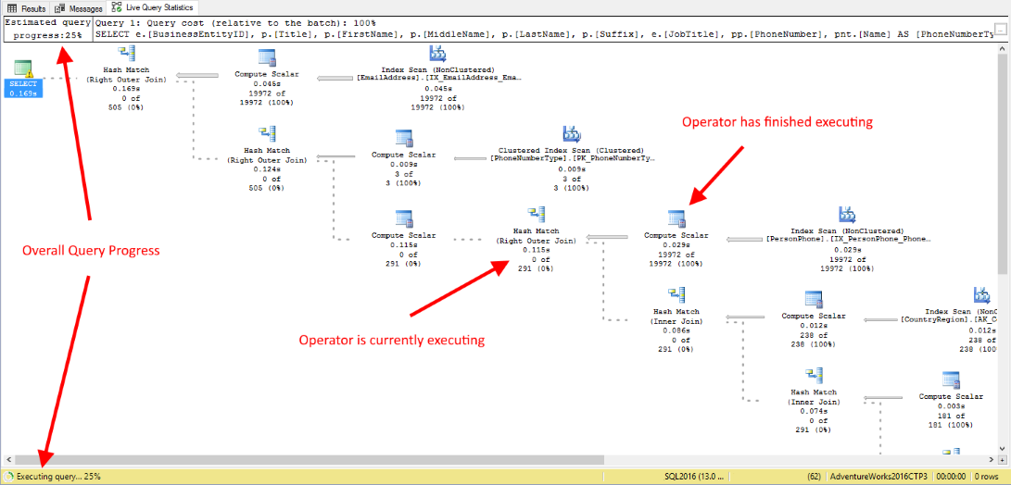
SSMS Graphical Plan
Live Query Statistics
View CPU/memory usage, execution time, and query progress
Allows drill down to live operator-level statistics, such as:
Number of generated rows
Elapsed time
Operator progress
Live warnings
This feature is primarily intended for troubleshooting purposes.
Using this feature can moderately slow the overall query performance.
Notes:
SQL Server Management Studio provides the ability to view the live execution plan of an active query. This live query plan provides real-time insights into the query execution process as the controls flow from one query plan operator to another. The live query plan displays the overall query progress and operator-level run-time execution statistics such as the number of rows produced, elapsed time, operator progress, and so on. Because this data is available in real time without needing to wait for the query to complete, these execution statistics are extremely useful for debugging query performance issues.
This feature is available beginning with SQL Server 2016 (13.x) Management Studio, however it can work with SQL Server 2014 (12.x).
Internally, live query statistics leverages the sys.dm_exec_query_profiles DMV.
To view live query statistics for one query, on the tools menu click the Include Live Query Statistics icon. The live execution plan can also be accessed from the Activity Monitor.
For further information refer to:
https://docs.microsoft.com/en-us/sql/relational-databases/performance/live-query-statistics

Slide 31












Execution Plan
Notable operators
Operators describe how SQL Server executes a query. The query optimizer uses operators to build a query plan to create the result specified in the query.
Table scan
Nonclustered index scan
Clustered index scan
Nonclustered index seek
Clustered index seek
Sort
RID lookup
Table spool
Key lookup
Index spool
ColumnStore Index Scan
Stream Aggregation
Notes:
Further Reading: Showplan Logical & Physical Operators Reference - SQL Server | Microsoft Learn
Operators describe how SQL Server executes a query or a Data Manipulation Language (DML) statement. The query optimizer uses operators to build a query plan to create the result specified in the query, or to perform the operation specified in the DML statement. The query plan is a tree consisting of physical operators. You can view the query plan by using the SET SHOWPLAN statements, the graphical execution plan options in SQL Server Management Studio, or the SQL Server Profiler Showplan event classes.
Operators are classified as logical and physical operators.
Logical Operators Logical operators describe the relational algebraic operation used to process a statement. In other words, logical operators describe conceptually what operation needs to be performed.
Physical Operators Physical operators implement the operation described by logical operators. Each physical operator is an object or routine that performs an operation. For example, some physical operators access columns or rows from a table, index or view. Other physical operators perform other operations such as calculations, aggregations, data integrity checks or joins. Physical operators have costs associated with them.
The Table Scan operator retrieves all rows from the table specified in the Argument column of the query execution plan. If a WHERE:() predicate appears in the Argument column, only those rows that satisfy the predicate are returned. Table Scan is a logical and physical operator. Normally used on Heap tables.
The Clustered Index Scan operator scans the clustered index specified in the Argument column of the query execution plan. When an optional WHERE:() predicate is present, only those rows that satisfy the predicate are returned. If the Argument column contains the ORDERED clause, the query processor has requested that the output of the rows be returned in the order in which the clustered index has sorted it. If the ORDERED clause is not present, the storage engine scans the index in the optimal way, without necessarily sorting the output. Clustered Index Scan is a logical and physical operator.
The Clustered Index Seek operator uses the seeking ability of indexes to retrieve rows from a clustered index. The Argument column contains the name of the clustered index being used and the SEEK:() predicate. The storage engine uses the index to process only those rows that satisfy this SEEK:() predicate. It can also include a WHERE:() predicate where the storage engine evaluates against all rows that satisfy the SEEK:() predicate, but this is optional and does not use indexes to complete this process.
RID Lookup is a bookmark lookup on a heap using a supplied row identifier (RID). The Argument column contains the bookmark label used to look up the row in the table and the name of the table in which the row is looked up. RID Lookup is always accompanied by a NESTED LOOP JOIN. RID Lookup is a physical operator.
The Key Lookup operator is a bookmark lookup on a table with a clustered index. The Argument column contains the name of the clustered index and the clustering key used to look up the row in the clustered index. Key Lookup is always accompanied by a Nested Loops operator. If the WITH PREFETCH clause appears in the Argument column, the query processor has determined that it is optimal to use asynchronous prefetching (read-ahead) when looking up bookmarks in the clustered index. The use of a Key Lookup operator in a query plan indicates that the query might benefit from performance tuning. For example, query performance might be improved by adding a covering index.
The Columnstore Index Scan operator scans the columnstore index specified in the Argument column of the query execution plan.
The Index Scan operator retrieves all rows from the nonclustered index specified in the Argument column. If an optional WHERE:() predicate appears in the Argument column, only those rows that satisfy the predicate are returned. Index Scan is a logical and physical operator.
The Index Seek operator uses the seeking ability of indexes to retrieve rows from a nonclustered index. The Argument column contains the name of the nonclustered index being used. It also contains the SEEK:() predicate. The storage engine uses the index to process only those rows that satisfy the SEEK:() predicate. It optionally may include a WHERE:() predicate, which the storage engine will evaluate against all rows that satisfy the SEEK:() predicate (it does not use the indexes to do this). If the Argument column contains the ORDERED clause, the query processor has determined that the rows must be returned in the order in which the nonclustered index has sorted them. If the ORDERED clause is not present, the storage engine searches the index in the optimal way (which does not guarantee that the output will be sorted). Allowing the output to retain its ordering may be less efficient than producing non-sorted output. Index Seek is a logical and physical operator.
The Sort operator sorts all incoming rows. The Argument column contains either a DISTINCT ORDER BY:() predicate if duplicates are removed by this operation, or an ORDER BY:() predicate with a comma-separated list of the columns being sorted. The columns are prefixed with the value ASC if the columns are sorted in ascending order, or the value DESC if the columns are sorted in descending order. Sort is a logical and physical operator.
The Table Spool operator scans the input and places a copy of each row in a hidden spool table that is stored in the tempdb database and existing only for the lifetime of the query. If the operator is rewound (for example, by a Nested Loops operator) but no rebinding is needed, the spooled data is used instead of rescanning the input. Table Spool is a physical operator.
The Index Spool physical operator contains a SEEK:() predicate in the Argument column. The Index Spool operator scans its input rows, placing a copy of each row in a hidden spool file (stored in the tempdb database and existing only for the lifetime of the query), and builds a nonclustered index on the rows. This allows you to use the seeking capability of indexes to output only those rows that satisfy the SEEK:() predicate. If the operator is rewound (for example, by a Nested Loops operator) but no rebinding is needed, the spooled data is used instead of rescanning the input.
The Stream Aggregate operator requires input ordered by the columns within its groups. The optimizer will use a Sort operator prior to this operator if the data is not already sorted due to a prior Sort operator or due to an ordered index seek or scan. In the SHOWPLAN_ALL statement or the graphical execution plan in SQL Server Management Studio, the columns in the GROUP BY predicate are listed in the Argument column, and the aggregate expressions are listed in the Defined Values column. Stream Aggregate is a physical operator.

Slide 32



Execution Plan Join Operators
A Merge Join is useful if both table inputs are in the same sorted order on the same value.
The Merge join is the most efficient join in SQL Server. In simple terms, if you see a Merge Join, your query plan is an efficient query plan and you do not need to do many changes to improve query performances. Since the Merge Join operator uses sorted data inputs, it can use any two large datasets.
A Hash Match is used when the tables being joined are not in the same sorted order.
A Nested Loop is use when a small (outer) table is used to lookup a value in a larger (inner) table.
Notes:
Further Reading: Joins (SQL Server) - SQL Server | Microsoft Learn
Merge Joins
If the two join inputs are not small but are sorted on their join column (for example, if they were obtained by scanning sorted indexes), a merge join is the fastest join operation. If both join inputs are large and the two inputs are of similar sizes, a merge join with prior sorting and a hash join offer similar performance. However, hash join operations are often much faster if the two input sizes differ significantly from each other.
The merge join requires both inputs to be sorted on the merge columns, which are defined by the equality (ON) clauses of the join predicate. The query optimizer typically scans an index, if one exists on the proper set of columns, or it places a sort operator below the merge join. In rare cases, there may be multiple equality clauses, but the merge columns are taken from only some of the available equality clauses.
Because each input is sorted, the Merge Join operator gets a row from each input and compares them. For example, for inner join operations, the rows are returned if they are equal. If they are not equal, the lower-value row is discarded and another row is obtained from that input. This process repeats until all rows have been processed.
The merge join operation may be either a regular or a many-to-many operation. A many-to-many merge join uses a temporary table to store rows. If there are duplicate values from each input, one of the inputs has to rewind to the start of the duplicates as each duplicate from the other input is processed.
If a residual predicate is present, all rows that satisfy the merge predicate evaluate the residual predicate, and only those rows that satisfy it are returned.
Merge join itself is very fast, but it can be an expensive choice if sort operations are required. However, if the data volume is large and the desired data can be obtained presorted from existing B-tree indexes, merge join is often the fastest available join algorithm.
Hash Match Joins
Hash joins can efficiently process large, unsorted, nonindexed inputs. They are useful for intermediate results in complex queries because:
Intermediate results are not indexed (unless explicitly saved to disk and then indexed) and often are not suitably sorted for the next operation in the query plan.
Query optimizers estimate only intermediate result sizes. Because estimates can be very inaccurate for complex queries, algorithms to process intermediate results not only must be efficient, but also must degrade gracefully if an intermediate result turns out to be much larger than anticipated.
The hash join allows reductions in the use of denormalization. Denormalization is typically used to achieve better performance by reducing join operations, in spite of the dangers of redundancy, such as inconsistent updates. Hash joins reduce the need to denormalize. Hash joins allow vertical partitioning (representing groups of columns from a single table in separate files or indexes) to become a viable option for physical database design.
The hash join has two inputs: the build input and probe input. The query optimizer assigns these roles so that the smaller of the two inputs is the build input.
Hash joins are used for many types of set-matching operations: inner join; left, right, and full outer join; left and right semi-join; intersection; union; and difference. Moreover, a variant of the hash join can do duplicate removal and grouping, such as SUM(salary) GROUP BY department. These modifications use only one input for both the build and probe roles.
Nested Loops Joins
If one join input is small (fewer than 10 rows) and the other join input is fairly large and indexed on its join columns, an index nested loops join is the fastest join operation because they require the least I/O and the fewest comparisons.
The nested loops join, also called nested iteration, uses one join input as the outer input table (shown as the top input in the graphical execution plan) and one as the inner (bottom) input table. The outer loop consumes the outer input table row by row. The inner loop, executed for each outer row, searches for matching rows in the inner input table.
In the simplest case, the search scans an entire table or index; this is called a naive nested loops join. If the search exploits an index, it is called an index nested loops join. If the index is built as part of the query plan (and destroyed upon completion of the query), it is called a temporary index nested loops join. All these variants are considered by the Query Optimizer.
A nested loops join is particularly effective if the outer input is small and the inner input is preindexed and large. In many small transactions, such as those affecting only a small set of rows, index nested loops joins are superior to both merge joins and hash joins. In large queries, however, nested loops joins are often not the optimal choice.
When the OPTIMIZED attribute of a Nested Loops join operator is set to True, it means that an Optimized Nested Loops (or Batch Sort) is used to minimize I/O when the inner side table is large, regardless of it being parallelized or not. The presence of this optimization in a given plan may not be very obvious when analyzing an execution plan, given the sort itself is a hidden operation. But by looking in the plan XML for the attribute OPTIMIZED, this indicates the Nested Loops join may try to reorder the input rows to improve I/O performance.

Slide 33
Join Operators
Merge Joins
If the two join inputs are not small but are sorted on their join column (for example, if they were obtained by scanning sorted indexes), a merge join is the fastest join operation. If both join inputs are large and the two inputs are of similar sizes, a merge join with prior sorting and a hash join offer similar performance. However, hash join operations are often much faster if the two input sizes differ significantly from each other.
The merge join requires both inputs to be sorted on the merge columns, which are defined by the equality (ON) clauses of the join predicate. The query optimizer typically scans an index, if one exists on the proper set of columns, or it places a sort operator below the merge join. In rare cases, there may be multiple equality clauses, but the merge columns are taken from only some of the available equality clauses.
Because each input is sorted, the Merge Join operator gets a row from each input and compares them. For example, for inner join operations, the rows are returned if they are equal. If they are not equal, the lower-value row is discarded and another row is obtained from that input. This process repeats until all rows have been processed.
The merge join operation may be either a regular or a many-to-many operation. A many-to-many merge join uses a temporary table to store rows. If there are duplicate values from each input, one of the inputs has to rewind to the start of the duplicates as each duplicate from the other input is processed.
If a residual predicate is present, all rows that satisfy the merge predicate evaluate the residual predicate, and only those rows that satisfy it are returned.
Merge join itself is very fast, but it can be an expensive choice if sort operations are required. However, if the data volume is large and the desired data can be obtained presorted from existing B-tree indexes, merge join is often the fastest available join algorithm.
Notes:
Further Reading: Joins (SQL Server) - SQL Server | Microsoft Learn
Merge Joins
If the two join inputs are not small but are sorted on their join column (for example, if they were obtained by scanning sorted indexes), a merge join is the fastest join operation. If both join inputs are large and the two inputs are of similar sizes, a merge join with prior sorting and a hash join offer similar performance. However, hash join operations are often much faster if the two input sizes differ significantly from each other.
The merge join requires both inputs to be sorted on the merge columns, which are defined by the equality (ON) clauses of the join predicate. The query optimizer typically scans an index, if one exists on the proper set of columns, or it places a sort operator below the merge join. In rare cases, there may be multiple equality clauses, but the merge columns are taken from only some of the available equality clauses.
Because each input is sorted, the Merge Join operator gets a row from each input and compares them. For example, for inner join operations, the rows are returned if they are equal. If they are not equal, the lower-value row is discarded and another row is obtained from that input. This process repeats until all rows have been processed.
The merge join operation may be either a regular or a many-to-many operation. A many-to-many merge join uses a temporary table to store rows. If there are duplicate values from each input, one of the inputs has to rewind to the start of the duplicates as each duplicate from the other input is processed.
If a residual predicate is present, all rows that satisfy the merge predicate evaluate the residual predicate, and only those rows that satisfy it are returned.
Merge join itself is very fast, but it can be an expensive choice if sort operations are required. However, if the data volume is large and the desired data can be obtained presorted from existing B-tree indexes, merge join is often the fastest available join algorithm.
Hash Match Joins
Hash joins can efficiently process large, unsorted, nonindexed inputs. They are useful for intermediate results in complex queries because:
Intermediate results are not indexed (unless explicitly saved to disk and then indexed) and often are not suitably sorted for the next operation in the query plan.
Query optimizers estimate only intermediate result sizes. Because estimates can be very inaccurate for complex queries, algorithms to process intermediate results not only must be efficient, but also must degrade gracefully if an intermediate result turns out to be much larger than anticipated.
The hash join allows reductions in the use of denormalization. Denormalization is typically used to achieve better performance by reducing join operations, in spite of the dangers of redundancy, such as inconsistent updates. Hash joins reduce the need to denormalize. Hash joins allow vertical partitioning (representing groups of columns from a single table in separate files or indexes) to become a viable option for physical database design.
The hash join has two inputs: the build input and probe input. The query optimizer assigns these roles so that the smaller of the two inputs is the build input.
Hash joins are used for many types of set-matching operations: inner join; left, right, and full outer join; left and right semi-join; intersection; union; and difference. Moreover, a variant of the hash join can do duplicate removal and grouping, such as SUM(salary) GROUP BY department. These modifications use only one input for both the build and probe roles.
Nested Loops Joins
If one join input is small (fewer than 10 rows) and the other join input is fairly large and indexed on its join columns, an index nested loops join is the fastest join operation because they require the least I/O and the fewest comparisons.
The nested loops join, also called nested iteration, uses one join input as the outer input table (shown as the top input in the graphical execution plan) and one as the inner (bottom) input table. The outer loop consumes the outer input table row by row. The inner loop, executed for each outer row, searches for matching rows in the inner input table.
In the simplest case, the search scans an entire table or index; this is called a naive nested loops join. If the search exploits an index, it is called an index nested loops join. If the index is built as part of the query plan (and destroyed upon completion of the query), it is called a temporary index nested loops join. All these variants are considered by the Query Optimizer.
A nested loops join is particularly effective if the outer input is small and the inner input is preindexed and large. In many small transactions, such as those affecting only a small set of rows, index nested loops joins are superior to both merge joins and hash joins. In large queries, however, nested loops joins are often not the optimal choice.
When the OPTIMIZED attribute of a Nested Loops join operator is set to True, it means that an Optimized Nested Loops (or Batch Sort) is used to minimize I/O when the inner side table is large, regardless of it being parallelized or not. The presence of this optimization in a given plan may not be very obvious when analyzing an execution plan, given the sort itself is a hidden operation. But by looking in the plan XML for the attribute OPTIMIZED, this indicates the Nested Loops join may try to reorder the input rows to improve I/O performance.

Slide 34
Join Operators
Hash Match Joins
Hash joins can efficiently process large, unsorted, nonindexed inputs.
They are useful for intermediate results in complex queries because:
Intermediate results are not indexed (unless explicitly saved to disk and then indexed) and often are not suitably sorted for the next operation in the query plan.
Query optimizers estimate only intermediate result sizes. Because estimates can be very inaccurate for complex queries, algorithms to process intermediate results not only must be efficient, but also must degrade gracefully if an intermediate result turns out to be much larger than anticipated.
The hash join allows reductions in the use of denormalization. Denormalization is typically used to achieve better performance by reducing join operations, in spite of the dangers of redundancy, such as inconsistent updates. Hash joins reduce the need to denormalize. Hash joins allow vertical partitioning (representing groups of columns from a single table in separate files or indexes) to become a viable option for physical database design.
The hash join has two inputs: the build input and probe input. The query optimizer assigns these roles so that the smaller of the two inputs is the build input.
Hash joins are used for many types of set-matching operations: inner join; left, right, and full outer join; left and right semi-join; intersection; union; and difference.
Moreover, a variant of the hash join can do duplicate removal and grouping, such as SUM(salary) GROUP BY department. These modifications use only one input for both the build and probe roles.
Notes:
Further Reading: Joins (SQL Server) - SQL Server | Microsoft Learn
Merge Joins
If the two join inputs are not small but are sorted on their join column (for example, if they were obtained by scanning sorted indexes), a merge join is the fastest join operation. If both join inputs are large and the two inputs are of similar sizes, a merge join with prior sorting and a hash join offer similar performance. However, hash join operations are often much faster if the two input sizes differ significantly from each other.
The merge join requires both inputs to be sorted on the merge columns, which are defined by the equality (ON) clauses of the join predicate. The query optimizer typically scans an index, if one exists on the proper set of columns, or it places a sort operator below the merge join. In rare cases, there may be multiple equality clauses, but the merge columns are taken from only some of the available equality clauses.
Because each input is sorted, the Merge Join operator gets a row from each input and compares them. For example, for inner join operations, the rows are returned if they are equal. If they are not equal, the lower-value row is discarded and another row is obtained from that input. This process repeats until all rows have been processed.
The merge join operation may be either a regular or a many-to-many operation. A many-to-many merge join uses a temporary table to store rows. If there are duplicate values from each input, one of the inputs has to rewind to the start of the duplicates as each duplicate from the other input is processed.
If a residual predicate is present, all rows that satisfy the merge predicate evaluate the residual predicate, and only those rows that satisfy it are returned.
Merge join itself is very fast, but it can be an expensive choice if sort operations are required. However, if the data volume is large and the desired data can be obtained presorted from existing B-tree indexes, merge join is often the fastest available join algorithm.
Hash Match Joins
Hash joins can efficiently process large, unsorted, nonindexed inputs. They are useful for intermediate results in complex queries because:
Intermediate results are not indexed (unless explicitly saved to disk and then indexed) and often are not suitably sorted for the next operation in the query plan.
Query optimizers estimate only intermediate result sizes. Because estimates can be very inaccurate for complex queries, algorithms to process intermediate results not only must be efficient, but also must degrade gracefully if an intermediate result turns out to be much larger than anticipated.
The hash join allows reductions in the use of denormalization. Denormalization is typically used to achieve better performance by reducing join operations, in spite of the dangers of redundancy, such as inconsistent updates. Hash joins reduce the need to denormalize. Hash joins allow vertical partitioning (representing groups of columns from a single table in separate files or indexes) to become a viable option for physical database design.
The hash join has two inputs: the build input and probe input. The query optimizer assigns these roles so that the smaller of the two inputs is the build input.
Hash joins are used for many types of set-matching operations: inner join; left, right, and full outer join; left and right semi-join; intersection; union; and difference. Moreover, a variant of the hash join can do duplicate removal and grouping, such as SUM(salary) GROUP BY department. These modifications use only one input for both the build and probe roles.
Nested Loops Joins
If one join input is small (fewer than 10 rows) and the other join input is fairly large and indexed on its join columns, an index nested loops join is the fastest join operation because they require the least I/O and the fewest comparisons.
The nested loops join, also called nested iteration, uses one join input as the outer input table (shown as the top input in the graphical execution plan) and one as the inner (bottom) input table. The outer loop consumes the outer input table row by row. The inner loop, executed for each outer row, searches for matching rows in the inner input table.
In the simplest case, the search scans an entire table or index; this is called a naive nested loops join. If the search exploits an index, it is called an index nested loops join. If the index is built as part of the query plan (and destroyed upon completion of the query), it is called a temporary index nested loops join. All these variants are considered by the Query Optimizer.
A nested loops join is particularly effective if the outer input is small and the inner input is preindexed and large. In many small transactions, such as those affecting only a small set of rows, index nested loops joins are superior to both merge joins and hash joins. In large queries, however, nested loops joins are often not the optimal choice.
When the OPTIMIZED attribute of a Nested Loops join operator is set to True, it means that an Optimized Nested Loops (or Batch Sort) is used to minimize I/O when the inner side table is large, regardless of it being parallelized or not. The presence of this optimization in a given plan may not be very obvious when analyzing an execution plan, given the sort itself is a hidden operation. But by looking in the plan XML for the attribute OPTIMIZED, this indicates the Nested Loops join may try to reorder the input rows to improve I/O performance.

Slide 35
Join Operators
Hash Joins
Efficiency with Large Datasets
Hash joins are generally more efficient than Nested Loops joins when dealing with large datasets. This is because Hash joins do not require the data to be sorted or indexed beforehand. Instead, they create a hash table in memory for one of the tables (usually the smaller one) and then probe this hash table with the rows from the other table. This can significantly reduce the number of comparisons needed, making Hash joins faster for large datasets
Reduced Sensitivity to Data Size
Nested Loops joins can become inefficient when the outer table is large, as the join operation involves scanning the inner table for each row of the outer table. This results in a time complexity proportional to the product of the sizes of the two tables. In contrast, Hash joins have a time complexity that is linear with respect to the size of the input tables, making them less sensitive to the size of the data3.
No Need for Indexes
Hash joins do not require indexes on the join columns, which can be beneficial when indexes are not available or when creating indexes is not feasible due to time or storage constraints. This makes Hash joins a versatile option for joining tables without suitable indexes
Parallel Execution
Hash joins can be easily parallelized, allowing them to take advantage of multiple processors to speed up the join operation. This can lead to significant performance improvements, especially on systems with multiple CPUs
Notes:
Further Reading: Joins (SQL Server) - SQL Server | Microsoft Learn
Merge Joins
If the two join inputs are not small but are sorted on their join column (for example, if they were obtained by scanning sorted indexes), a merge join is the fastest join operation. If both join inputs are large and the two inputs are of similar sizes, a merge join with prior sorting and a hash join offer similar performance. However, hash join operations are often much faster if the two input sizes differ significantly from each other.
The merge join requires both inputs to be sorted on the merge columns, which are defined by the equality (ON) clauses of the join predicate. The query optimizer typically scans an index, if one exists on the proper set of columns, or it places a sort operator below the merge join. In rare cases, there may be multiple equality clauses, but the merge columns are taken from only some of the available equality clauses.
Because each input is sorted, the Merge Join operator gets a row from each input and compares them. For example, for inner join operations, the rows are returned if they are equal. If they are not equal, the lower-value row is discarded and another row is obtained from that input. This process repeats until all rows have been processed.
The merge join operation may be either a regular or a many-to-many operation. A many-to-many merge join uses a temporary table to store rows. If there are duplicate values from each input, one of the inputs has to rewind to the start of the duplicates as each duplicate from the other input is processed.
If a residual predicate is present, all rows that satisfy the merge predicate evaluate the residual predicate, and only those rows that satisfy it are returned.
Merge join itself is very fast, but it can be an expensive choice if sort operations are required. However, if the data volume is large and the desired data can be obtained presorted from existing B-tree indexes, merge join is often the fastest available join algorithm.
Hash Match Joins
Hash joins can efficiently process large, unsorted, nonindexed inputs. They are useful for intermediate results in complex queries because:
Intermediate results are not indexed (unless explicitly saved to disk and then indexed) and often are not suitably sorted for the next operation in the query plan.
Query optimizers estimate only intermediate result sizes. Because estimates can be very inaccurate for complex queries, algorithms to process intermediate results not only must be efficient, but also must degrade gracefully if an intermediate result turns out to be much larger than anticipated.
The hash join allows reductions in the use of denormalization. Denormalization is typically used to achieve better performance by reducing join operations, in spite of the dangers of redundancy, such as inconsistent updates. Hash joins reduce the need to denormalize. Hash joins allow vertical partitioning (representing groups of columns from a single table in separate files or indexes) to become a viable option for physical database design.
The hash join has two inputs: the build input and probe input. The query optimizer assigns these roles so that the smaller of the two inputs is the build input.
Hash joins are used for many types of set-matching operations: inner join; left, right, and full outer join; left and right semi-join; intersection; union; and difference. Moreover, a variant of the hash join can do duplicate removal and grouping, such as SUM(salary) GROUP BY department. These modifications use only one input for both the build and probe roles.
Nested Loops Joins
If one join input is small (fewer than 10 rows) and the other join input is fairly large and indexed on its join columns, an index nested loops join is the fastest join operation because they require the least I/O and the fewest comparisons.
The nested loops join, also called nested iteration, uses one join input as the outer input table (shown as the top input in the graphical execution plan) and one as the inner (bottom) input table. The outer loop consumes the outer input table row by row. The inner loop, executed for each outer row, searches for matching rows in the inner input table.
In the simplest case, the search scans an entire table or index; this is called a naive nested loops join. If the search exploits an index, it is called an index nested loops join. If the index is built as part of the query plan (and destroyed upon completion of the query), it is called a temporary index nested loops join. All these variants are considered by the Query Optimizer.
A nested loops join is particularly effective if the outer input is small and the inner input is preindexed and large. In many small transactions, such as those affecting only a small set of rows, index nested loops joins are superior to both merge joins and hash joins. In large queries, however, nested loops joins are often not the optimal choice.
When the OPTIMIZED attribute of a Nested Loops join operator is set to True, it means that an Optimized Nested Loops (or Batch Sort) is used to minimize I/O when the inner side table is large, regardless of it being parallelized or not. The presence of this optimization in a given plan may not be very obvious when analyzing an execution plan, given the sort itself is a hidden operation. But by looking in the plan XML for the attribute OPTIMIZED, this indicates the Nested Loops join may try to reorder the input rows to improve I/O performance.

Slide 36
Join Operators
Nested Loops Joins
If one join input is small (fewer than 10 rows) and the other join input is fairly large and indexed on its join columns, an index nested loops join is the fastest join operation because they require the least I/O and the fewest comparisons.
The nested loops join, also called nested iteration, uses one join input as the outer input table (shown as the top input in the graphical execution plan) and one as the inner (bottom) input table. The outer loop consumes the outer input table row by row. The inner loop, executed for each outer row, searches for matching rows in the inner input table.
In the simplest case, the search scans an entire table or index; this is called a naive nested loops join. If the search exploits an index, it is called an index nested loops join. If the index is built as part of the query plan (and destroyed upon completion of the query), it is called a temporary index nested loops join. All these variants are considered by the Query Optimizer.
A nested loops join is particularly effective if the outer input is small and the inner input is preindexed and large. In many small transactions, such as those affecting only a small set of rows, index nested loops joins are superior to both merge joins and hash joins. In large queries, however, nested loops joins are often not the optimal choice.
When the OPTIMIZED attribute of a Nested Loops join operator is set to True, it means that an Optimized Nested Loops (or Batch Sort) is used to minimize I/O when the inner side table is large, regardless of it being parallelized or not. The presence of this optimization in a given plan may not be very obvious when analyzing an execution plan, given the sort itself is a hidden operation. But by looking in the plan XML for the attribute OPTIMIZED, this indicates the Nested Loops join may try to reorder the input rows to improve I/O performance.
Notes:
Further Reading: Joins (SQL Server) - SQL Server | Microsoft Learn
Merge Joins
If the two join inputs are not small but are sorted on their join column (for example, if they were obtained by scanning sorted indexes), a merge join is the fastest join operation. If both join inputs are large and the two inputs are of similar sizes, a merge join with prior sorting and a hash join offer similar performance. However, hash join operations are often much faster if the two input sizes differ significantly from each other.
The merge join requires both inputs to be sorted on the merge columns, which are defined by the equality (ON) clauses of the join predicate. The query optimizer typically scans an index, if one exists on the proper set of columns, or it places a sort operator below the merge join. In rare cases, there may be multiple equality clauses, but the merge columns are taken from only some of the available equality clauses.
Because each input is sorted, the Merge Join operator gets a row from each input and compares them. For example, for inner join operations, the rows are returned if they are equal. If they are not equal, the lower-value row is discarded and another row is obtained from that input. This process repeats until all rows have been processed.
The merge join operation may be either a regular or a many-to-many operation. A many-to-many merge join uses a temporary table to store rows. If there are duplicate values from each input, one of the inputs has to rewind to the start of the duplicates as each duplicate from the other input is processed.
If a residual predicate is present, all rows that satisfy the merge predicate evaluate the residual predicate, and only those rows that satisfy it are returned.
Merge join itself is very fast, but it can be an expensive choice if sort operations are required. However, if the data volume is large and the desired data can be obtained presorted from existing B-tree indexes, merge join is often the fastest available join algorithm.
Hash Match Joins
Hash joins can efficiently process large, unsorted, nonindexed inputs. They are useful for intermediate results in complex queries because:
Intermediate results are not indexed (unless explicitly saved to disk and then indexed) and often are not suitably sorted for the next operation in the query plan.
Query optimizers estimate only intermediate result sizes. Because estimates can be very inaccurate for complex queries, algorithms to process intermediate results not only must be efficient, but also must degrade gracefully if an intermediate result turns out to be much larger than anticipated.
The hash join allows reductions in the use of denormalization. Denormalization is typically used to achieve better performance by reducing join operations, in spite of the dangers of redundancy, such as inconsistent updates. Hash joins reduce the need to denormalize. Hash joins allow vertical partitioning (representing groups of columns from a single table in separate files or indexes) to become a viable option for physical database design.
The hash join has two inputs: the build input and probe input. The query optimizer assigns these roles so that the smaller of the two inputs is the build input.
Hash joins are used for many types of set-matching operations: inner join; left, right, and full outer join; left and right semi-join; intersection; union; and difference. Moreover, a variant of the hash join can do duplicate removal and grouping, such as SUM(salary) GROUP BY department. These modifications use only one input for both the build and probe roles.
Nested Loops Joins
If one join input is small (fewer than 10 rows) and the other join input is fairly large and indexed on its join columns, an index nested loops join is the fastest join operation because they require the least I/O and the fewest comparisons.
The nested loops join, also called nested iteration, uses one join input as the outer input table (shown as the top input in the graphical execution plan) and one as the inner (bottom) input table. The outer loop consumes the outer input table row by row. The inner loop, executed for each outer row, searches for matching rows in the inner input table.
In the simplest case, the search scans an entire table or index; this is called a naive nested loops join. If the search exploits an index, it is called an index nested loops join. If the index is built as part of the query plan (and destroyed upon completion of the query), it is called a temporary index nested loops join. All these variants are considered by the Query Optimizer.
A nested loops join is particularly effective if the outer input is small and the inner input is preindexed and large. In many small transactions, such as those affecting only a small set of rows, index nested loops joins are superior to both merge joins and hash joins. In large queries, however, nested loops joins are often not the optimal choice.
When the OPTIMIZED attribute of a Nested Loops join operator is set to True, it means that an Optimized Nested Loops (or Batch Sort) is used to minimize I/O when the inner side table is large, regardless of it being parallelized or not. The presence of this optimization in a given plan may not be very obvious when analyzing an execution plan, given the sort itself is a hidden operation. But by looking in the plan XML for the attribute OPTIMIZED, this indicates the Nested Loops join may try to reorder the input rows to improve I/O performance.

Slide 37
Demonstration
Query Plan Analysis
Use the graphical execution plan and IO statistics to tune a query.
Explore Live Query Statistics.
Notes:
Previous demonstration files are under E:\Archived.
You can open all the demonstrations by using the solutions file :
E:\Demos\SQL_PTO_Workshop_Demos.ssmssln
Individual SQL demo file.
E:\Demos\07_Execution_Plans\AnalyzingPlanOperators.sql
E:\Demos\07_Execution_Plans\LiveQueryStatistics.sql

Slide 38
Query Plan Analysis
Identifying and tuning high cost operators in the query plan
Notes:
M07L03Lab01

Slide 39
Knowledge Check
Q1: What is a method to eliminate a lookup?
A1: A lookup can be eliminated with a nonclustered covering index.
Q2:Is it recommended to eliminate all lookups operators?
A2: No, removing all lookup operators could cause that you create big non clustered indexes that can cause index maintenance to be non practical. You must remove lookup operators only when the performance gain will be really significant.
Q3: Under what circumstances would a table scan be more efficient than an index seek on a non-clustered, non-covering index?
A3: If the number of logical reads in a table scan is less than the number of logical reads for a seek and lookup for each row required by an operation.
Q4: Is a Clustered Index Scan more efficient than a Table Scan?
A4: No, even when the plan “uses” an index, the Clustered Index is just the table ordered so it is as bad as a table scan. Consider that the Clustered Index is bigger than the HEAP so scanning the clustered index can cause more IO than scanning the HEAP.
Notes:
Q1: What is a method to eliminate a lookup?
A1: A lookup can be eliminated with a nonclustered covering index.
Q2:Is it recommended to eliminate all lookups operators?
A2: No, removing all lookup operators could cause that you create big non clustered indexes that can cause index maintenance to be non practical. You must remove lookup operators only when the performance gain will be really significant.
Q3: Under what circumstances would a table scan be more efficient than an index seek on a non-clustered, non-covering index?
A3: If the number of logical reads in a table scan is less than the number of logical reads for a seek and lookup for each row required by an operation.
Q4: Is a Clustered Index Scan more efficient than a Table Scan?
A4: No, even when the plan “uses” an index, the Clustered Index is just the table ordered so it is as bad as a table scan. Consider that the Clustered Index is bigger than the HEAP so scanning the clustered index can cause more IO than scanning the HEAP.

Slide 40
CTEs Benefits
Readability and Maintainability: CTEs make complex queries easier to read and maintain. By breaking down a complex query into smaller, more manageable parts, CTEs help you understand and debug the query more easily. This is particularly useful when dealing with multiple joins or subqueries.
Recursive Queries: CTEs are particularly useful for recursive queries, such as hierarchical data retrieval. A recursive CTE can reference itself, making it easier to write queries that need to traverse hierarchical structures.
Temporary Result Sets: CTEs provide a way to create temporary result sets that can be referenced multiple times within the same query. This can be more efficient than using nested subqueries, as it avoids the need to repeat the same subquery multiple times.
Modularity: CTEs allow you to modularize your query logic. You can define a CTE once and then reference it multiple times within the same query, which can help reduce code duplication and improve query performance.
Complex Aggregations: When you need to perform complex aggregations or window functions, CTEs can help by allowing you to separate different stages of the query into distinct, named result sets. This can make it easier to apply different aggregations or window functions to different parts of the data.

Slide 41
CTEs potential issues
Performance Issues: CTEs can sometimes lead to performance issues, especially if they are used inappropriately or excessively. For example, if a CTE is used in a query that is executed frequently, it can cause the query to run slower than if a temporary table or indexed view were used.
Limited Scope: CTEs can only be referenced within the same statement in which they are defined. This means that they cannot be used across multiple statements or in different parts of a batch.
Complexity in Recursive CTEs: While recursive CTEs are powerful, they can also be complex and difficult to debug if not written carefully. Recursive CTEs can lead to infinite loops if the termination condition is not properly defined.

Slide 42
CTEs Best Practices
Use CTEs for Readability: Use CTEs to break down complex queries into smaller, more manageable parts. This will make your queries easier to read and maintain.
Limit the Use of Recursive CTEs: Use recursive CTEs only when necessary and ensure that the termination condition is well-defined to avoid infinite loops.
Avoid Overusing CTEs: While CTEs are useful, overusing them can lead to performance issues. Consider using temporary tables or indexed views for queries that are executed frequently.
Test Performance: Always test the performance of your queries with CTEs and compare them with alternative approaches, such as using subqueries, temporary tables, or indexed views.
Use CTEs for Modularity: Take advantage of the modularity that CTEs offer by defining them once and referencing them multiple times within the same query. This can help reduce code duplication and improve query performance.

Slide 43
Demonstration
Query Plan Analysis
CTEs

Slide 44
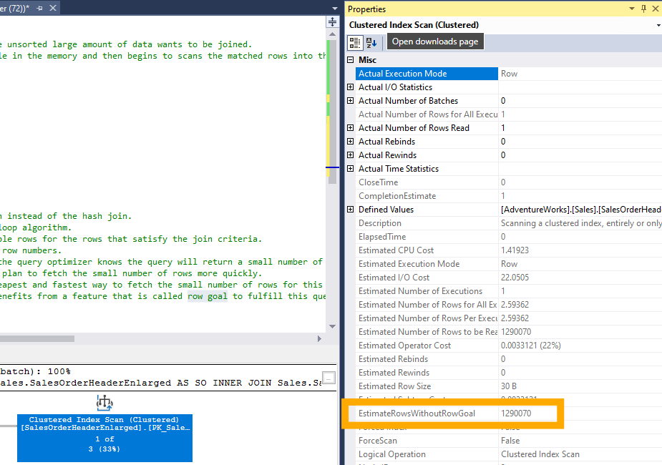
Top n impact on the query plan
How Row Goal Works
When the query optimizer generates an execution plan,
it typically aims to process all qualifying rows from the data
sources.
However, certain query constructs, such as
TOP, FAST, IN, EXISTS, and SET ROWCOUNT,
can set a row goal, which tells the optimizer to aim for
a smaller number of rows.
This can lead to more efficient execution plans for queries that are expected to return a limited number of rows.
EstimateRowsWithoutRowGoal: SQL Server 2019 introduced a new attribute in the query execution plan called
EstimateRowsWithoutRowGoal. This attribute helps to identify whether the query plan was influenced by a row goal. It allows you to compare the estimated number of rows with and without the row goal to understand its impact on the execution plan

Slide 45
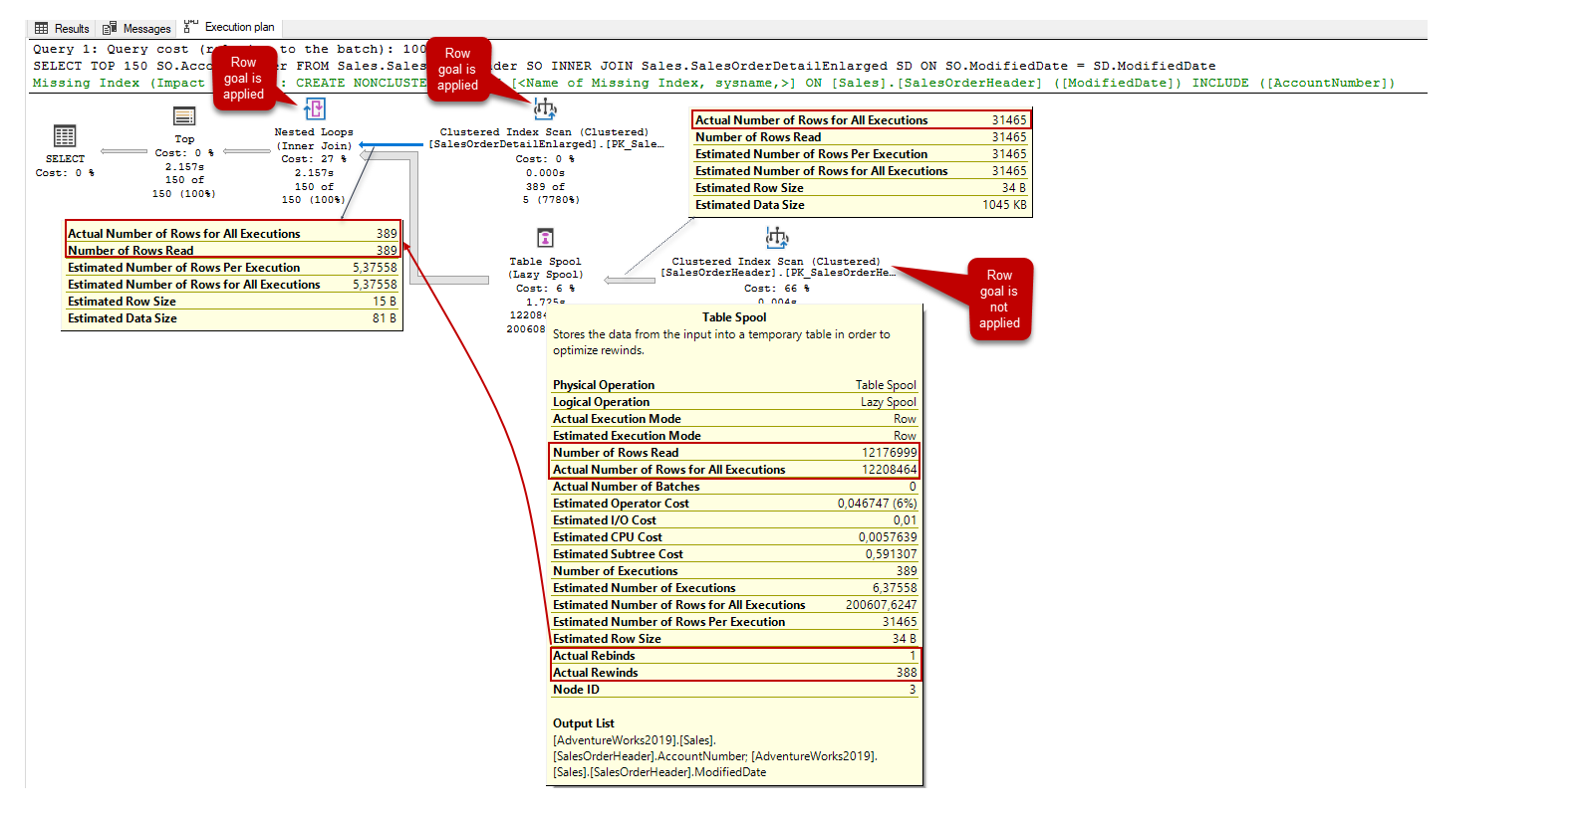
Row Goal
SELECT TOP 150 SO.AccountNumber FROM
Sales.SalesOrderHeader SO
INNER JOIN Sales.SalesOrderDetailEnlarged SD
ON SO.ModifiedDate = SD.ModifiedDate

Slide 46
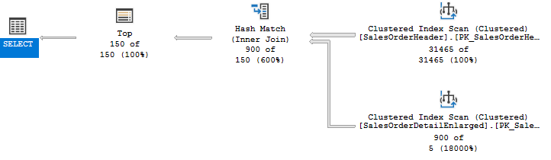
Avoiding the table spool operator can reduce the I/O performance of the query so it helps to improve query performance.
In general, we may observe the table spool operator with the nested loop join but we can force the optimizer to change this join type with other alternative join types. We can use the OPTION clause to add some hints that can force the optimizer to
change the optimal query plan.
In order to get rid of the table spool operator, we can force the optimizer to use a hash join instead of the nested loop join.
To do this, we will add the OPTION (HASH JOIN) statement at the end of the query.
SELECT TOP 150 SO.AccountNumber FROM
Sales.SalesOrderHeader SO
INNER JOIN Sales.SalesOrderDetailEnlarged SD
ON SO.ModifiedDate = SD.ModifiedDate
OPTION( HASH JOIN)

Slide 47
Table Spools operator is used to improve performance of the query performance but sometimes
it can cause performance bottlenecks.
SELECT TOP 150 SO.AccountNumber
FROM Sales.SalesOrderHeader SO
INNER HASH JOIN Sales.SalesOrderDetailEnlarged SD
ON SO.ModifiedDate = SD.ModifiedDate
OPTION(NO_PERFORMANCE_SPOOL)
SQL TOP statement performance tips

